Slide 1
Find Edge Library (ADD STEPS OF FLOWCHART ON EVERY SLIDE)
Aneesh Batchu
Aug 4th, 2024
Our team: Aleksandar, Jiabao, Steven

Slide 2
Goal: Convert 3D lidar points into calculation of the road edge
Road edge: Pavement ends and vegetation begins

Slide 3
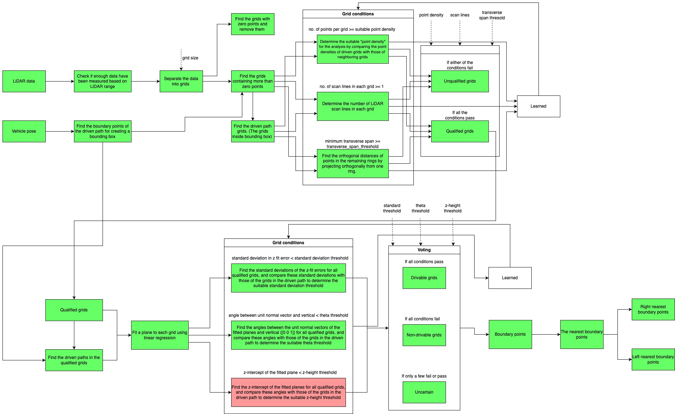
Overview

Slide 4
LiDAR scans (1400 -1450) XYZ point cloud with intensities. The RHS plot is a zoomed-in plot of the LHS

Slide 5
Valid scans

Slide 6
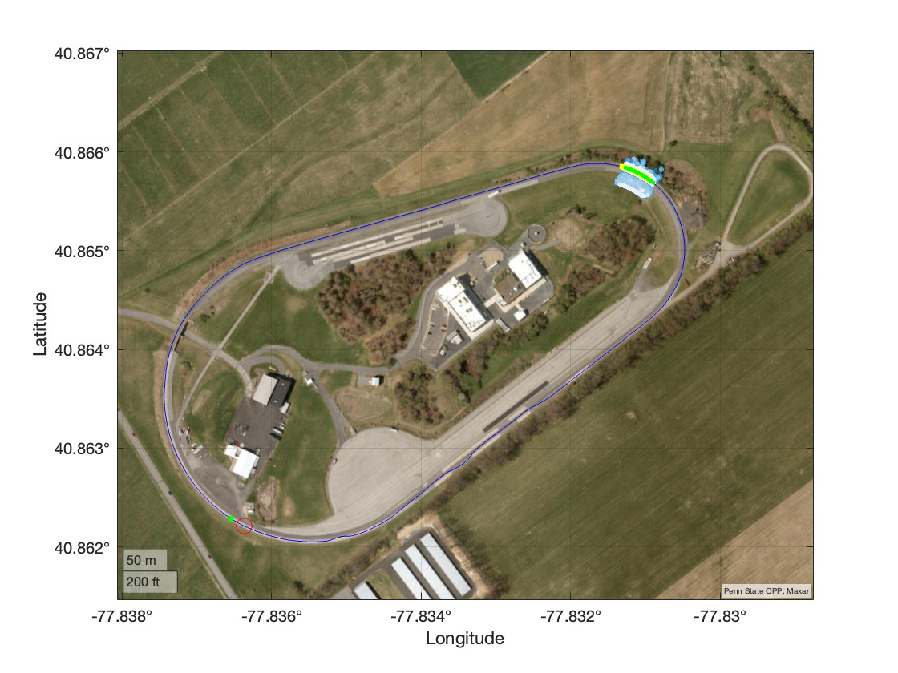
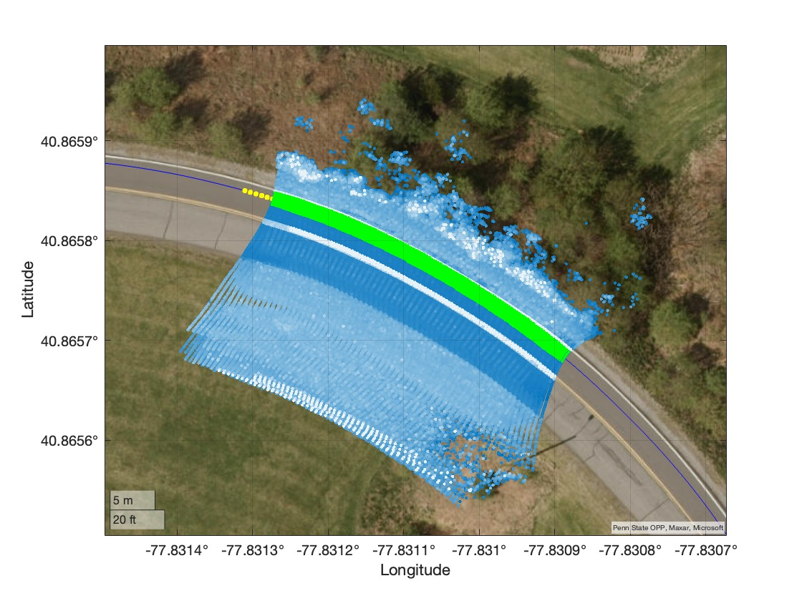
LiDAR data along with the driven path is plotted in a geo plot. The green path indicates the driven path of the mapping van. The RHS plot is the zoomed-in plot of the LHS

Slide 7
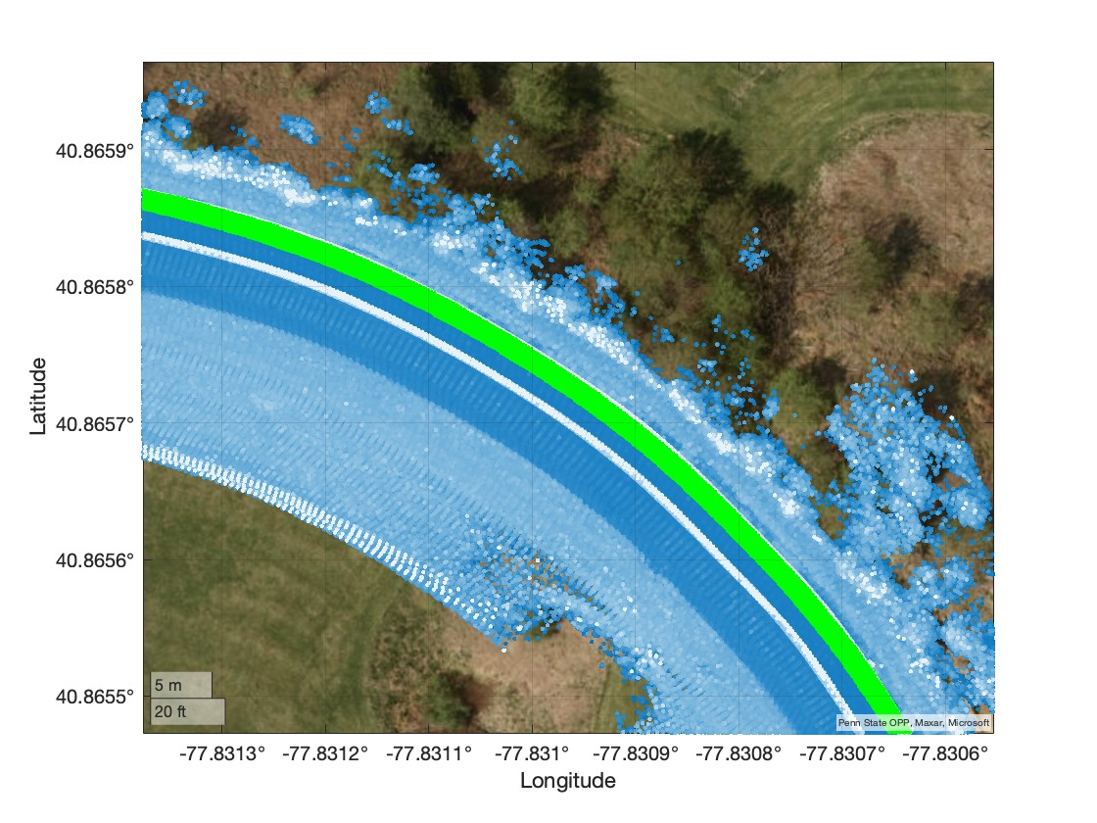
The gaps in the LiDAR scans (1400-1450) (LHS) indicate that insufficient data was captured. To address this, the indices of the scan lines that are 100 meters (the range of LiDAR) before station 1 (1400) and 100 meters after station 2 (1450) were determined by computing the distances of the scan lines from each station.

Slide 8
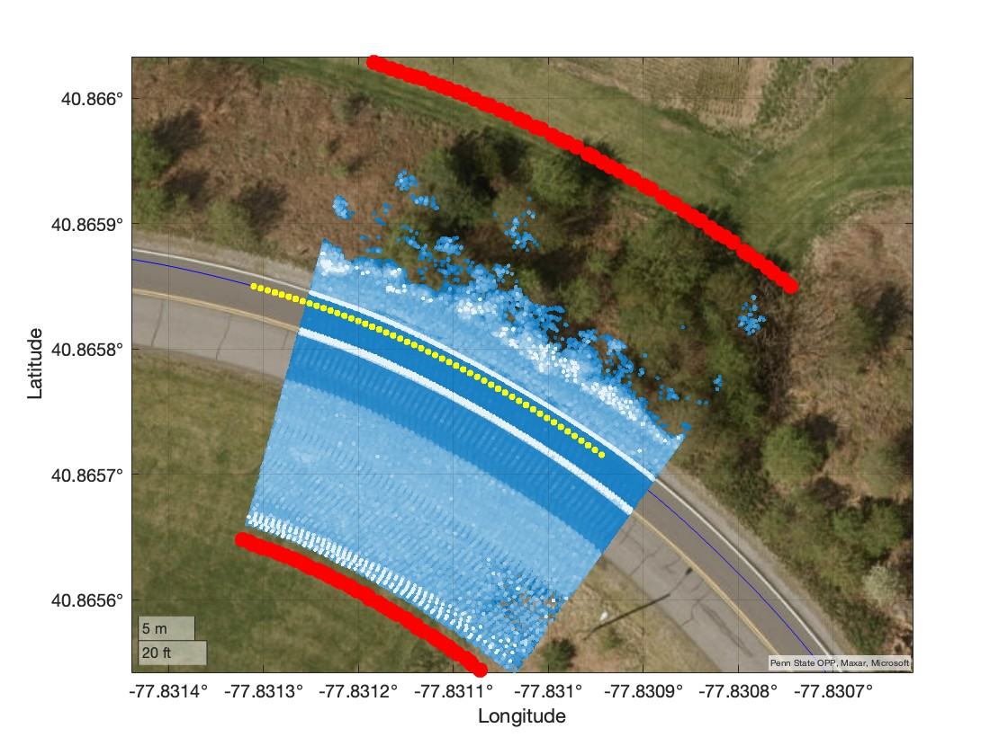
The points in the domain are selected by extending the orthogonal vector of the change in the XY position of the vehicle by six times the lane width XXX meters. All the points within these boundaries (red points) are considered to be in the domain.

Slide 9
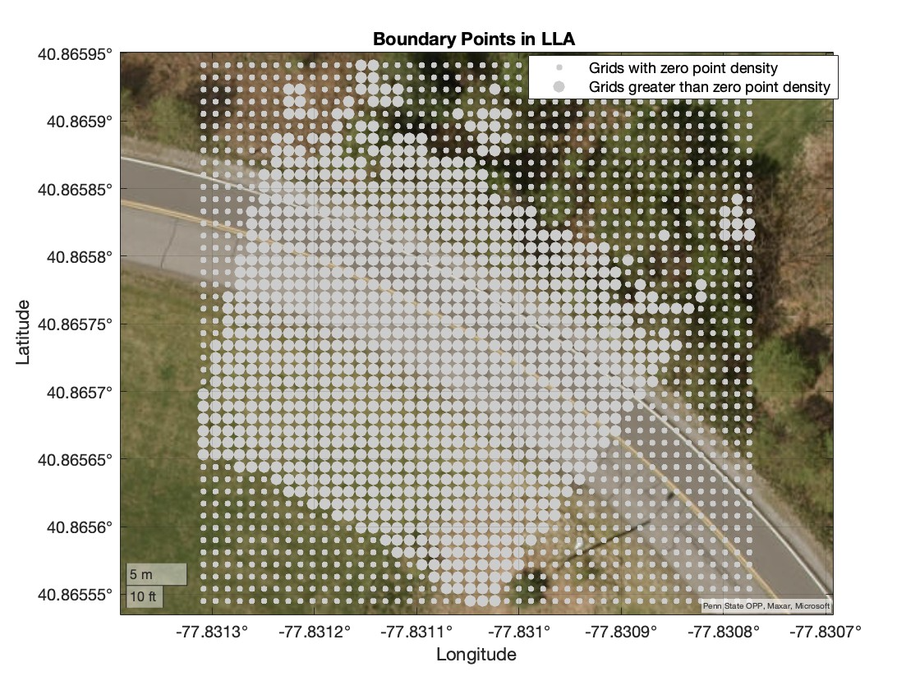
LiDAR data is segmented into grids to classify them into those with zero points and those with more than zero points. The grids with zero points are then dropped from the further analysis.

Slide 10
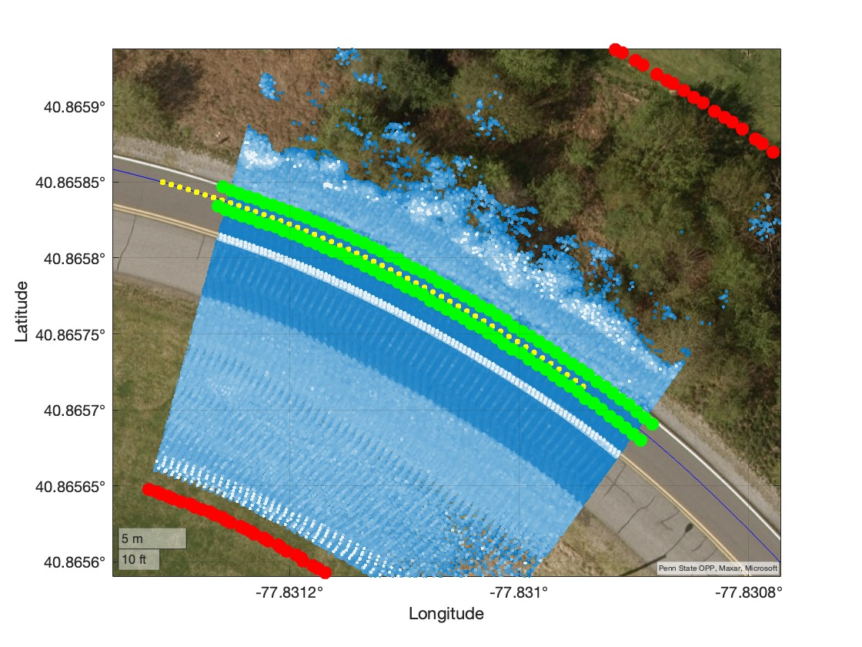
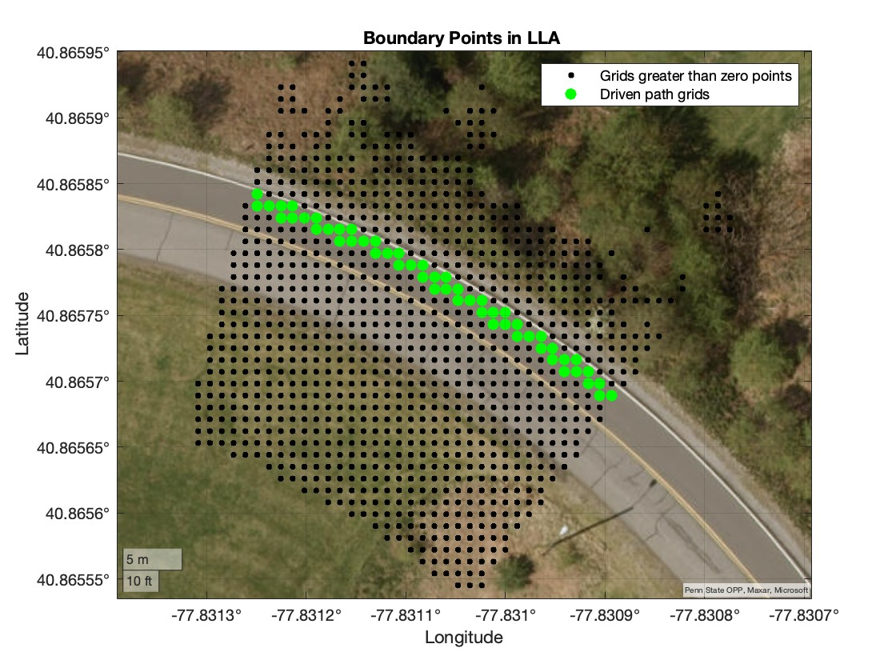
The boundary points of the driven path are computed by extending the unit orthogonal vectors of the vehicle's position to determine the driven path grids. The driven path grids are plotted in the RHS plot.

Slide 11
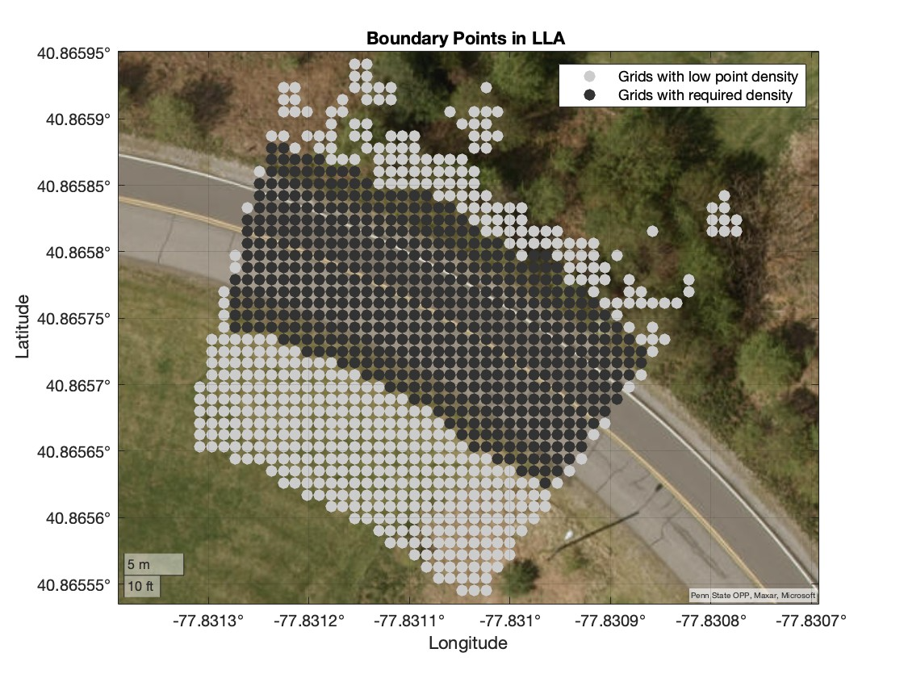
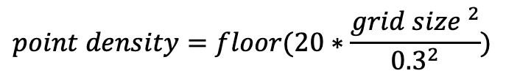
Grid Condition: Determine the point density (points per grid) by comparing the driven path densities with those of neighboring grids. This comparison has been done for multiple datasets with different grid sizes. The orange and blue bins correspond to the point densities of the driven path and all the grids, respectively. For plane fitting in the next steps, it was determined that each grid should contain at least 20 points when the grid size is 0.3 m (0.3 × 0.3). Therefore, this criterion has been extrapolated for other grid sizes as well. In the current analysis, the grid size is chosen as 1 m. The chosen point density for the current analysis is shown as a black point on the points per grid axis. The RHS plot depicts the grids with the required point density and those with insufficient point density. DON’T WRITE BIG DESCRIPTIONS – MAX 3 lines
$$point density=floor(20∗\frac{{grid size }^{2}}{{0.3}^{2}})$$
The point density is calculated as:

Slide 12
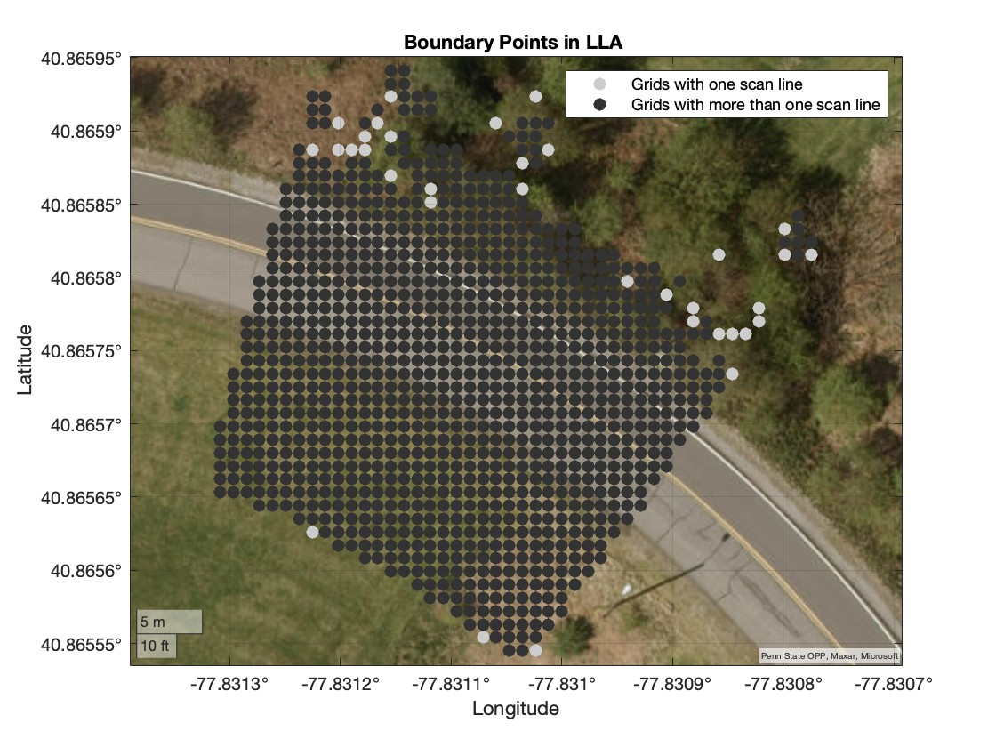
Grid Condition: Determine the number of scan lines in grids with more than zero points. Grids containing only one scan line cannot be used to fit a plane, as the angle deviation in these grids is high and they are automatically classified as uncertain grids (neither drivable nor non-drivable). To reduce the number of uncertain grids, these grids are identified and dropped from further analysis. Fitting a plane and angle deviation are discussed in the following slides. ADD A PLANE WITH ONE SCAN LINE and ANOTHER WITH 2 0r 3

Slide 13
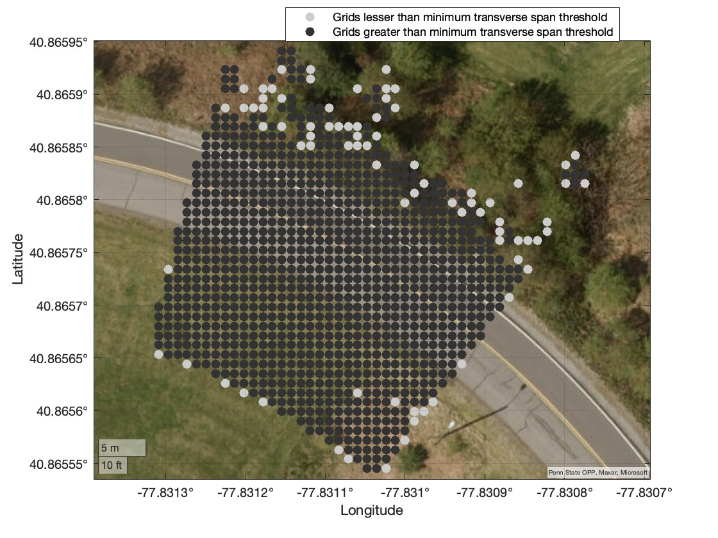
Grid Condition: Sometimes, grids containing more than one scan line may still be classified as uncertain (as discussed in later slides) due to the overlapping of scan lines within the grid. It has been found that the minimum span distance of each grid should be at least 0.15 meters, based on an analysis of various locations and grid sizes.

Slide 14
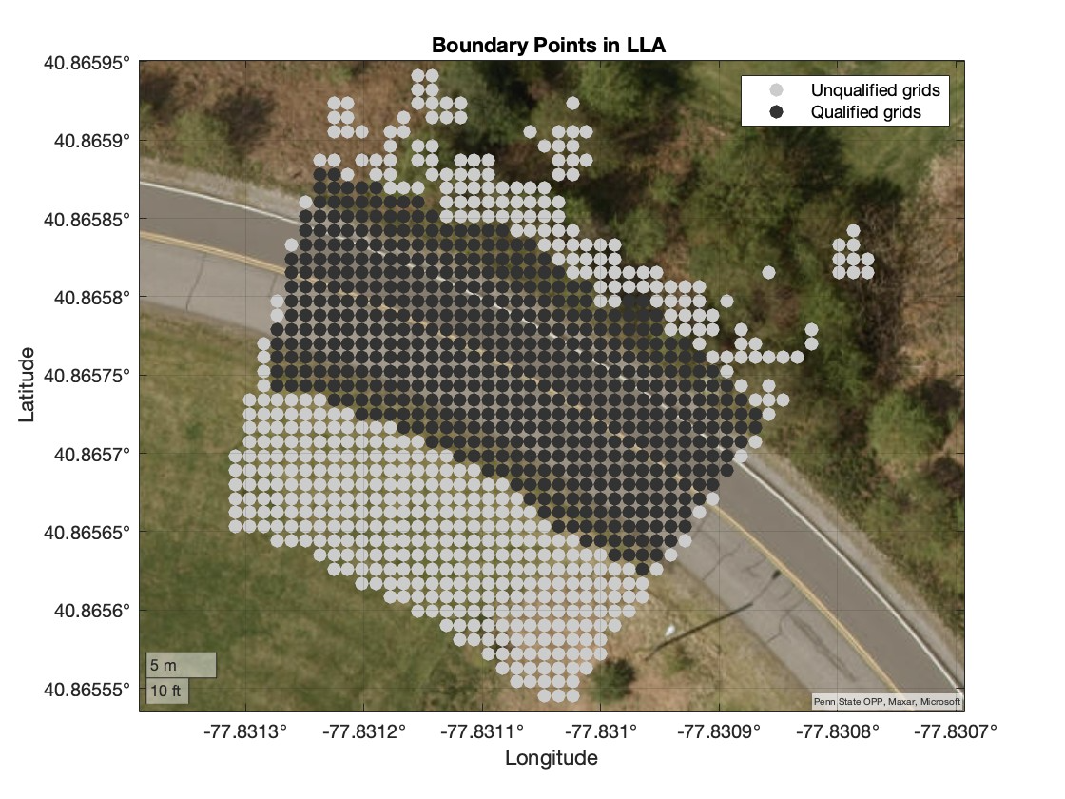
Grids that contain sufficient point density, have more than one scan line, and meet the minimum span distance are classified as qualified grids. The remaining grids are classified as unqualified and are dropped from further analysis.

Slide 15
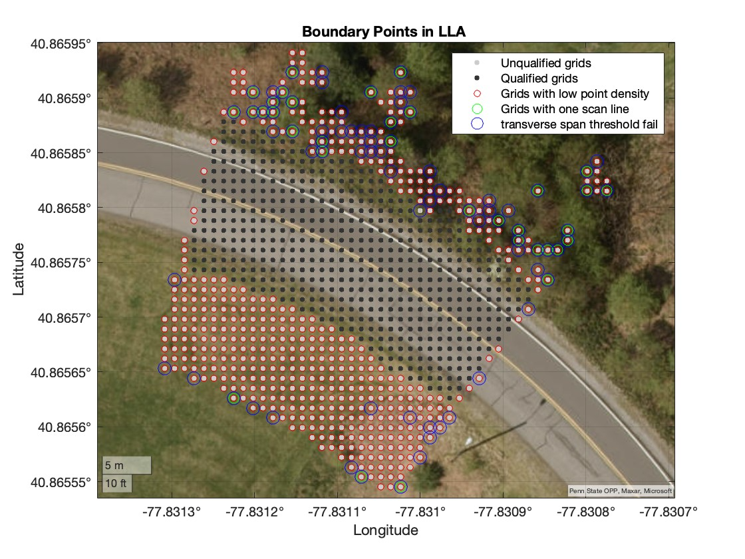
The failed conditions of unqualified grids are highlighted with different color circles.

Slide 16
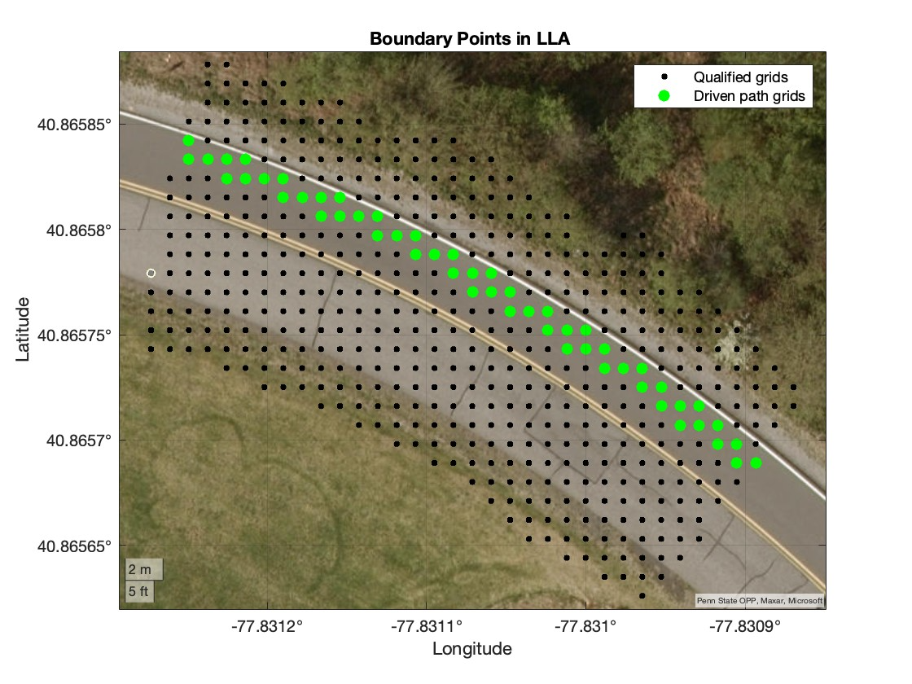
Recalculate the driven path grids for the qualified grids for further analysis. A

Slide 17
Grid Condition: Find the standard deviations of the z-errors for all qualified grids by fitting a plane and compare these standard deviations with those of the grids in the driven path to determine a suitable standard deviation threshold. This comparison has been done for multiple datasets with the same grid size. The orange and blue bins correspond to the standard deviations of the driven path and all the grids, respectively. Initially, the standard deviation threshold is selected by choosing 3-5 standard deviations above the mean of the standard deviations of the driven path grids. Later, the threshold is slightly adjusted manually to find the most suitable value. The grid centers enclosed in green circles are the grid centers of the driven path. SHOW PLANE FITS FIRST

Slide 18
Plane fitting of a driven path grid (standard deviation in z-error = 0.02 m and angle deviation = 5.03 degrees) and a grid with a standard deviation of 0.12 m, with an angle deviation (the angle between the green unit vector of [0 0 1]) ) of 3.2 degrees.

Slide 19
Grid Condition: Find the angles between the unit normal vectors of the fitted planes and the vertical vector ([0 0 1]) for qualified grids, and compare these angles with those of the grids in the driven path to determine a suitable theta threshold. This comparison has been conducted for multiple datasets with the same grid size. The orange and blue bins correspond to the angle deviations of the driven path and all the grids, respectively. Initially, the angle deviation threshold is selected by choosing 3 standard deviations above the mean of the angle deviations of the driven path grids. Later, the threshold is slightly adjusted manually to find the most suitable value. The grid centers enclosed in green circles are the grid centers of the driven path.

Slide 20
Plane fitting of a driven path grid (standard deviation in z-error = 0.02 m and angle deviation = 5.03 degrees) and a grid with a standard deviation of 0.07 m, with an angle deviation of 10.29 degrees (the angle between the green vector and the unit vector [0 0 1]).

Slide 21
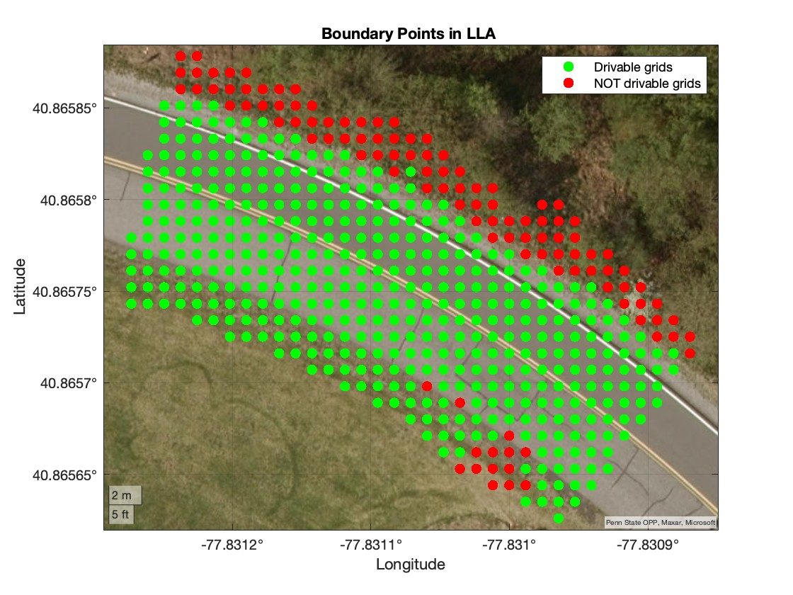
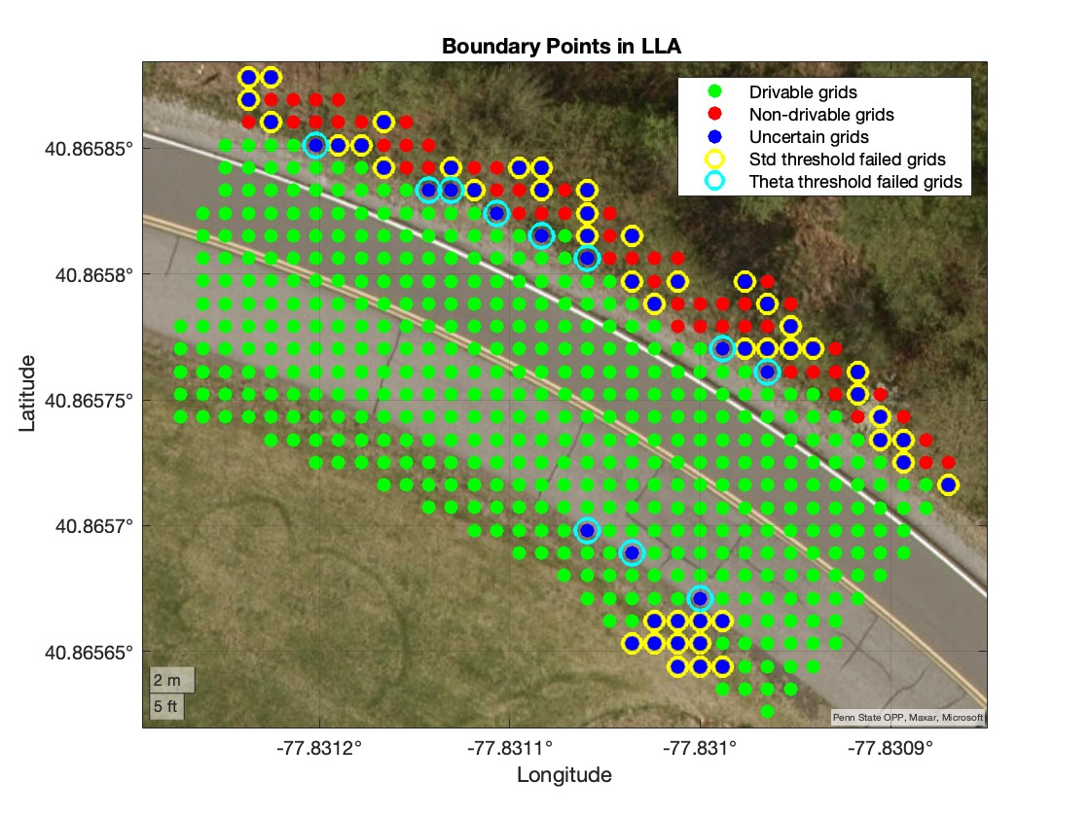
Voting: Drivable, Non-drivable, and Uncertain grids. The LHS plot shows drivable grids and non-drivable (including uncertain) grids.

Slide 22
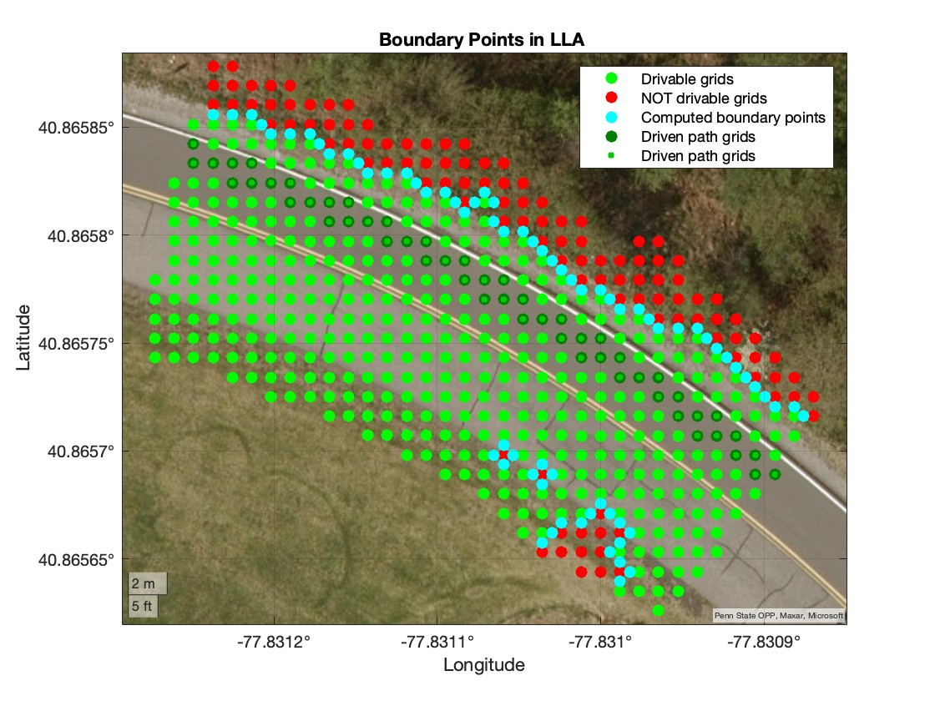
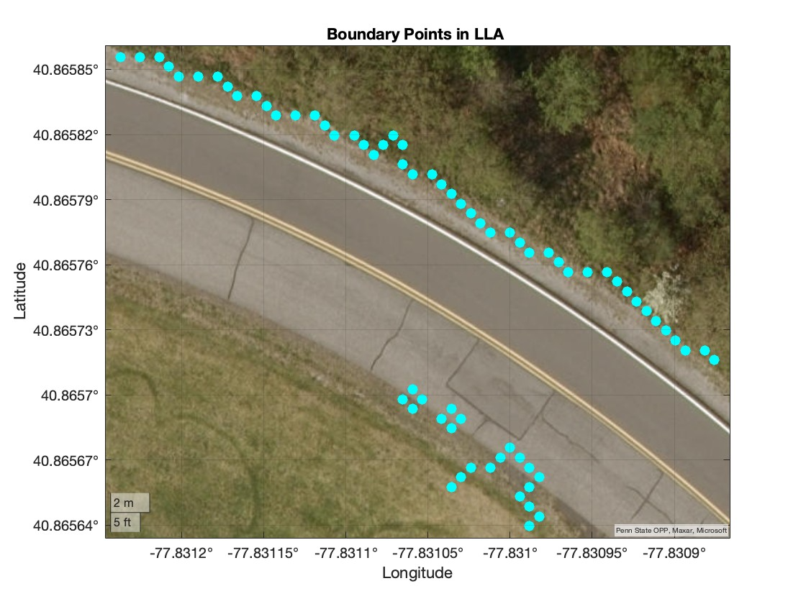
Boundary points: The boundary points of drivable and non-drivable surfaces. The RHS plot contains only boundary points

Slide 23
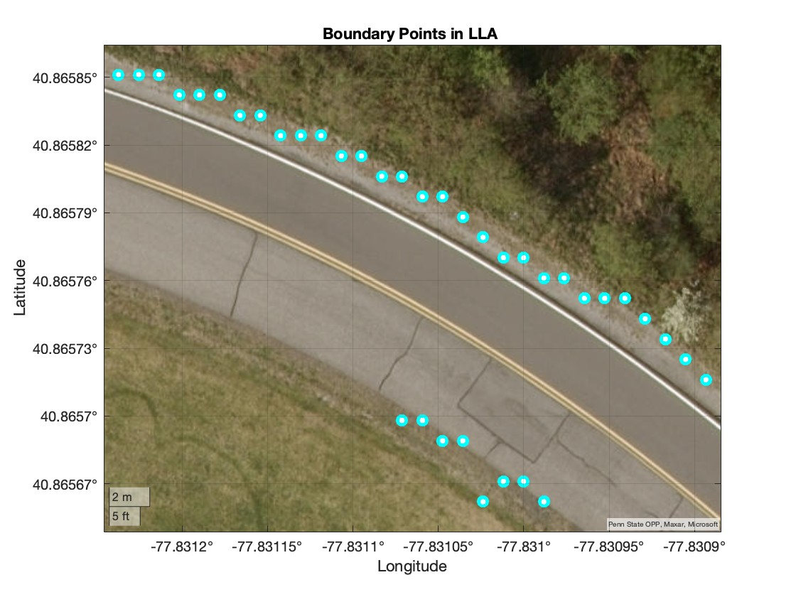
Nearest boundary points

Slide 24
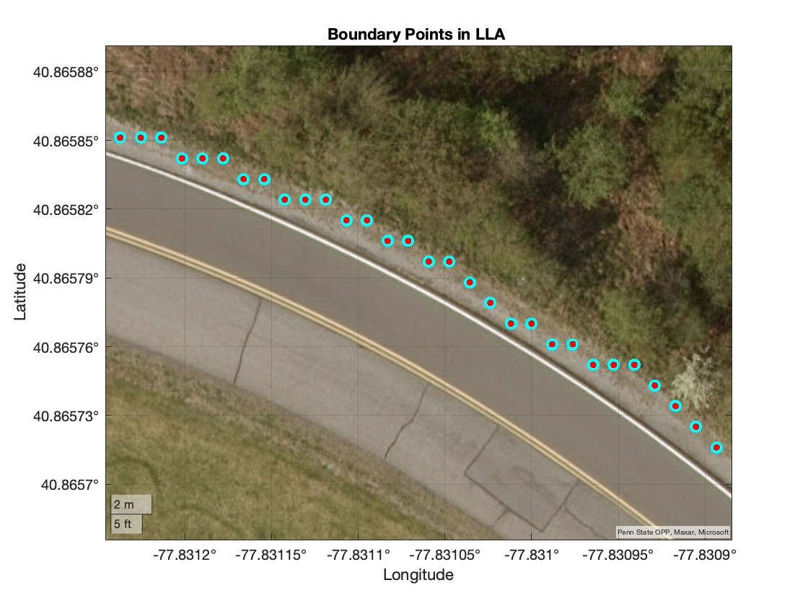
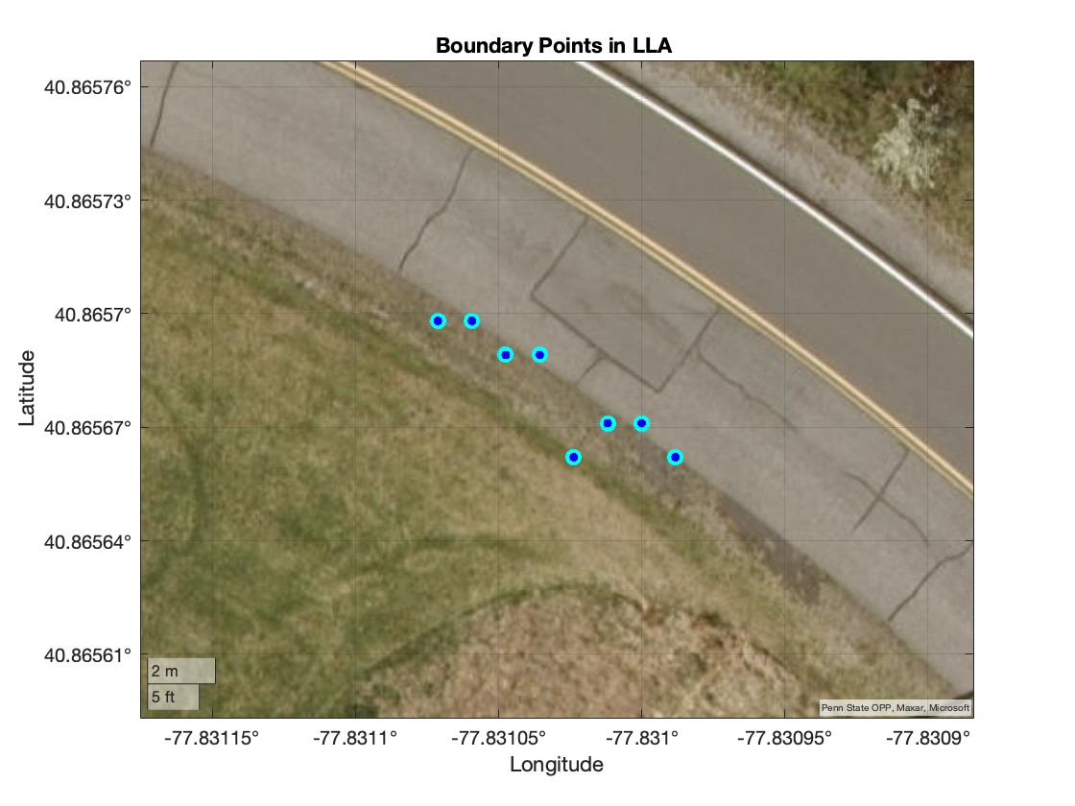
Nearest right and left boundaries

